Slide 1

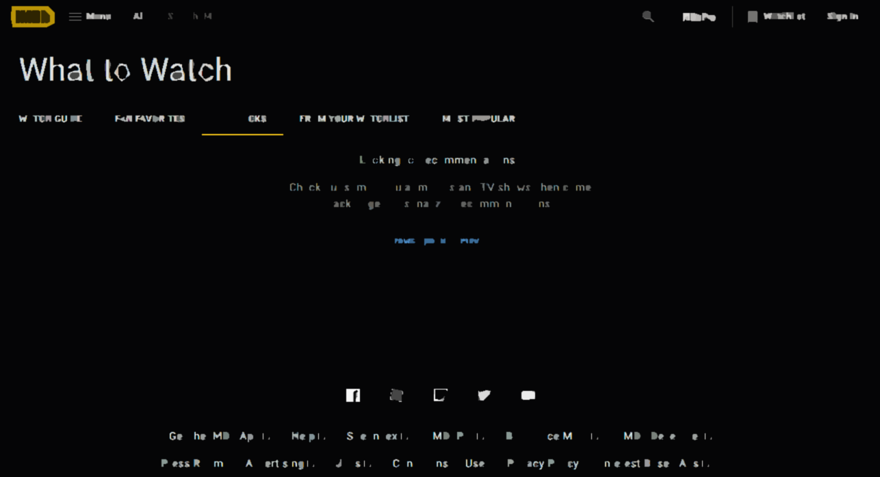
Analyzing IMDB
Movies
TEAM | ID
Mahmoud Hasan | 1710681
Ismail El-Azzazy | 1610448
Salma Adel | 1710995
Mohamed Kamel | 19100330
Mohamed Waleed | 1710109
George Atef | 1710211

Slide 2
Introduction
Film production studios are continuously producing new films at an increasing rate.
Online streaming services like Netflix and Amazon Prime have also started producing their own movies. This huge increase in movie titles has given the consumer a wide variety of choices.

Slide 3
Problem and aim
This increase is a drawback to recommending movies to specific consumers and demographics.
We aim to solve this issue by applying data analysis to rank movies from a large database of movies.

Slide 4
Algorithm
The following equation calculates the likability of recommending a certain movie based on score obtained from a weighted rank.
We use IMDB's weighted rating
Where:
v is the number of votes for the movie
m is the minimum votes required to be listed in the chart
R is the average rating of the movie
C is the mean vote
Weighted rating = (v/(v+m) R) + (m/(m+v) C)

Slide 5
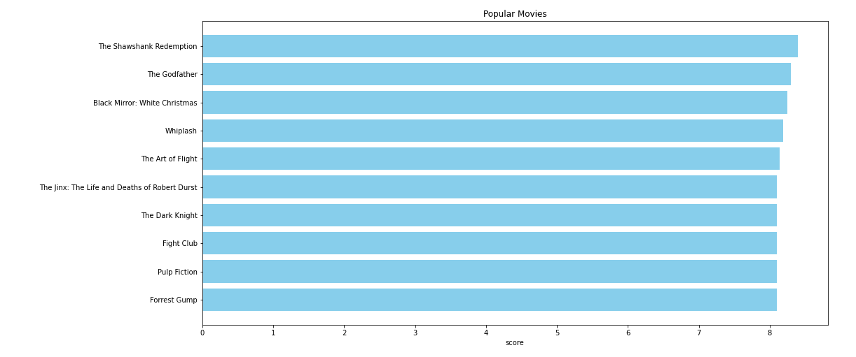
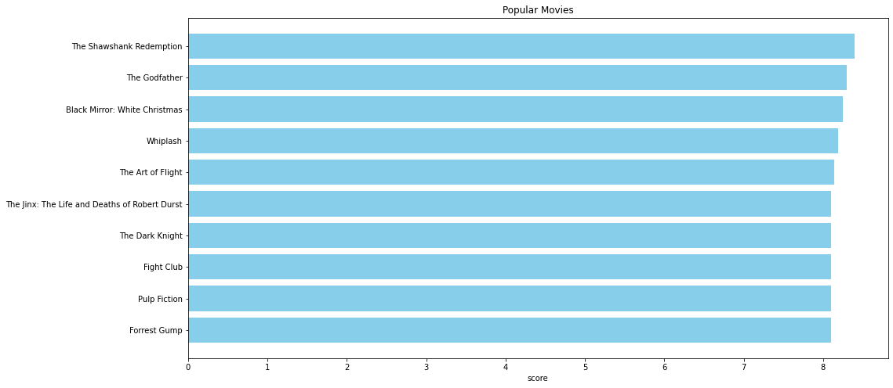
Results
This plot shows that The Shawshank Redemption has the highest score of all time. The original IMDB list on the website confirm most of the results in this chart.
Results

Slide 6
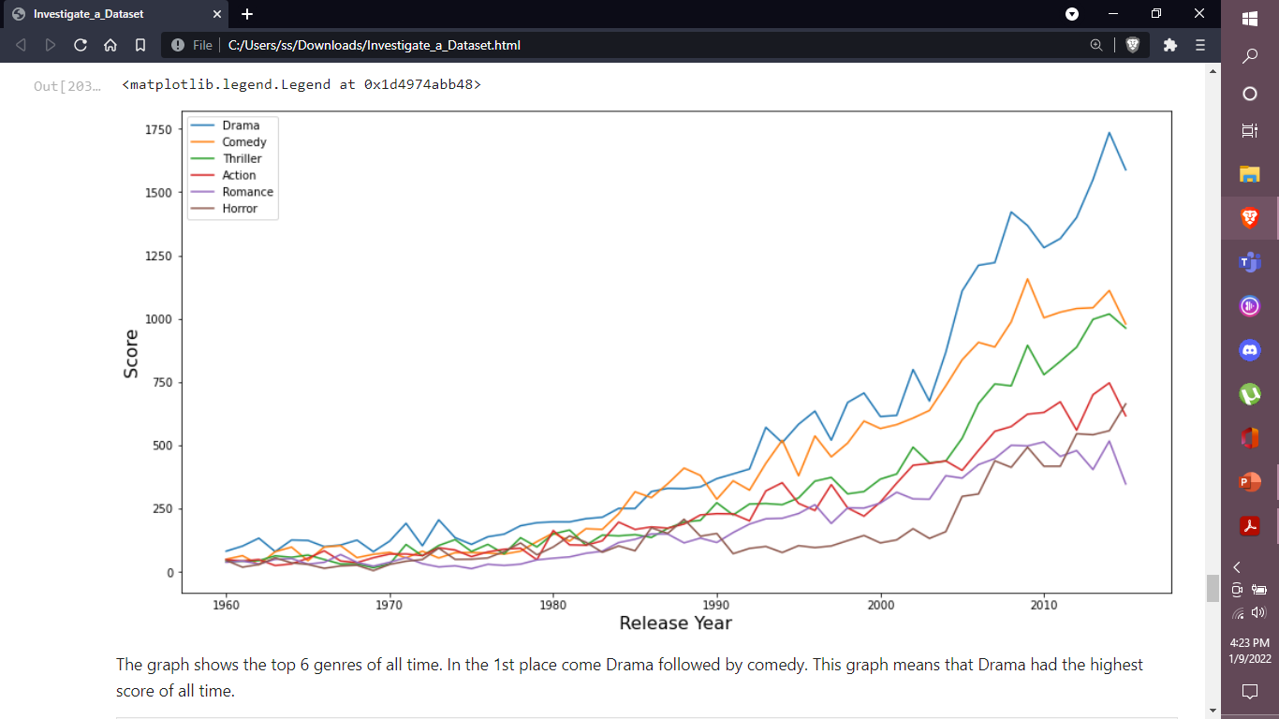
Results
The graph shows the top 6 genres of all time. In the 1st place comes Drama, followed by comedy.
This graph means that Drama has the highest score of all time.
Results

Slide 7
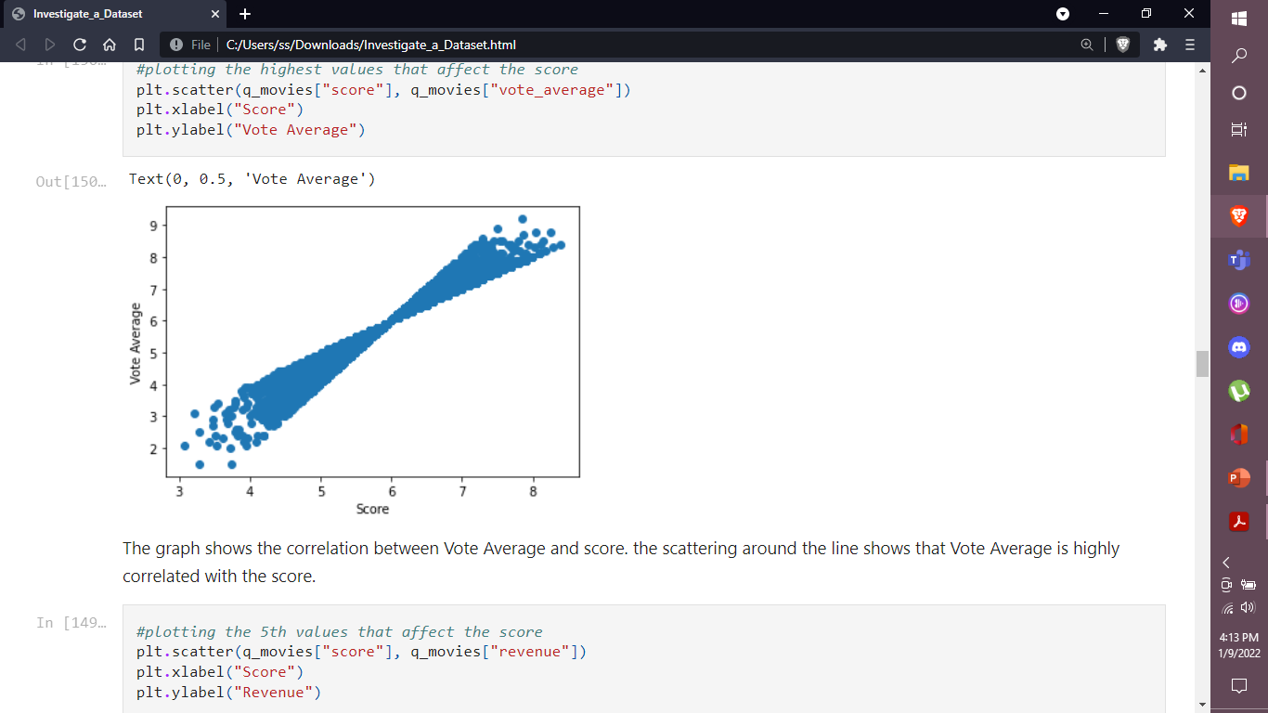
Results
The graph shows the correlation between Vote Average and score.
The scattering around the line shows that Vote Average is highly correlated with the score.

Slide 8
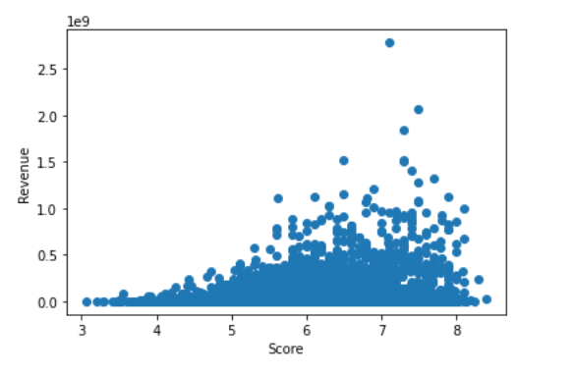
Results
The 5th correlated 'Revenue' with score shows that it's not correlated with the score.
This is evidence that Revenue doesn't affect the score that much

Slide 9
One of the limitations we faced was the necessity to separate the genres tag into more genres.
Limitations
The problem was that most of the movies contained more than one genre.
We used string cutting to separate the different genres and analyze all.

Slide 10
Successful application of several advanced data parsing and analysis methods.
Research skills by reading through academic journals and searching for useful resources.
Correct use of Pandas as well as several secondary libraries.
What we learned from this project

Slide 11
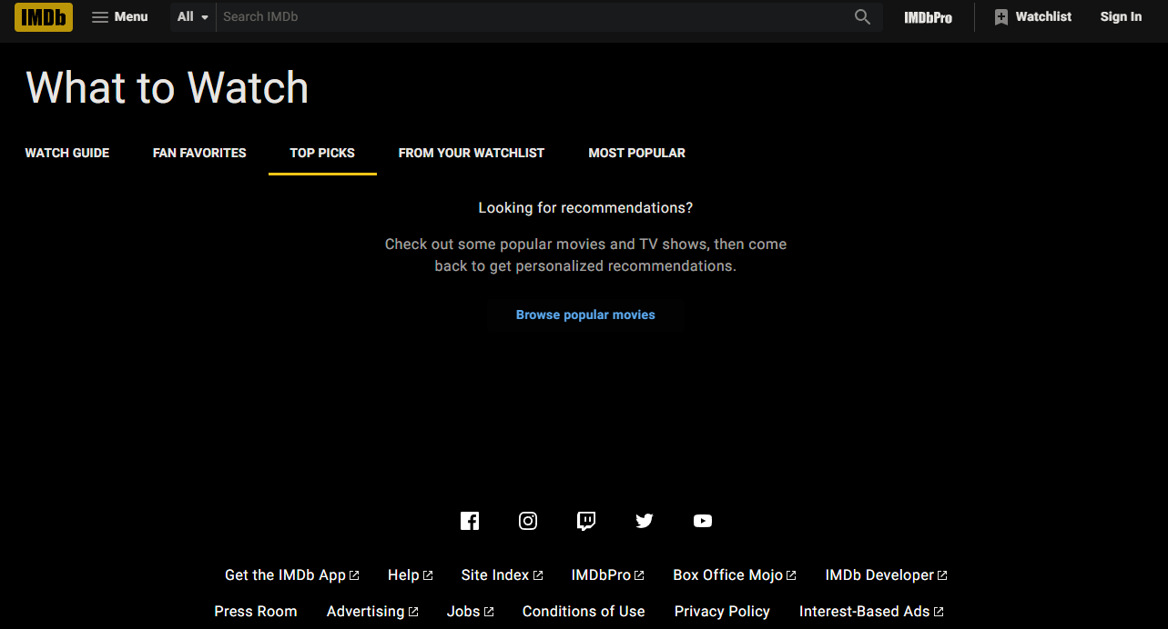
Thank you!

